Slide 1
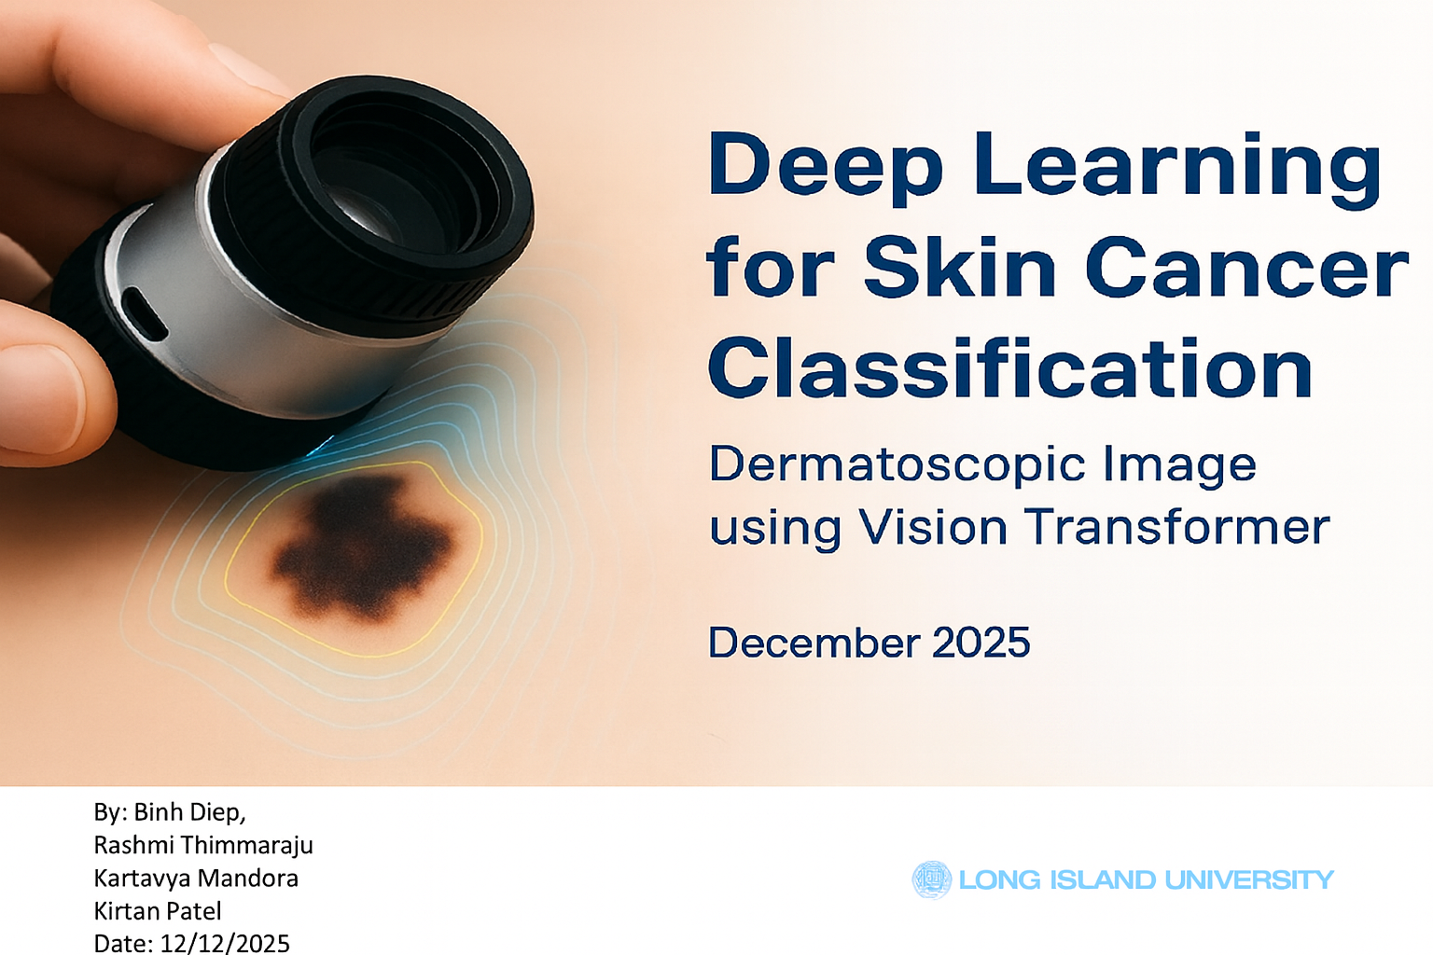

Project Title
By: Binh Diep, Rashmi Thimmaraju Kartavya Mandora Kirtan Patel
Date: 12/12/2025
AI700-001_BK_FALL2025

Slide 2
OUTLINES
TABLE OF CONTENTS
01
Overview
07
Training Loop for ViT based Patch15-224
02
Application
08
Understanding the functions
03
Literature Review
09
Timeline
04
Ham10000 dataset
10
Model Evaluation
05
Algorithm/Methodology
11
Conclusion & Future Work
06
Transformer Model
12
References

Slide 3
OVERVIEW: SKIN CANCERS AND PREVALENCE
Prevalence
The most common cancer in the United States
1 in 5 American will develop skin cancer by the age of 70
Greater than 200,000 people will be diagnosed
with melanoma in 2025
Benign
Malignant
Survival Rate 99%
Melanocytic Nevi
Dermato Fibroma
Benign Keratosis
Vascular Lesions
Early Detection
Melanoma (mel)
Basal Cell Carcinoma
Actinic Keratosis
Early Intervention

Slide 4
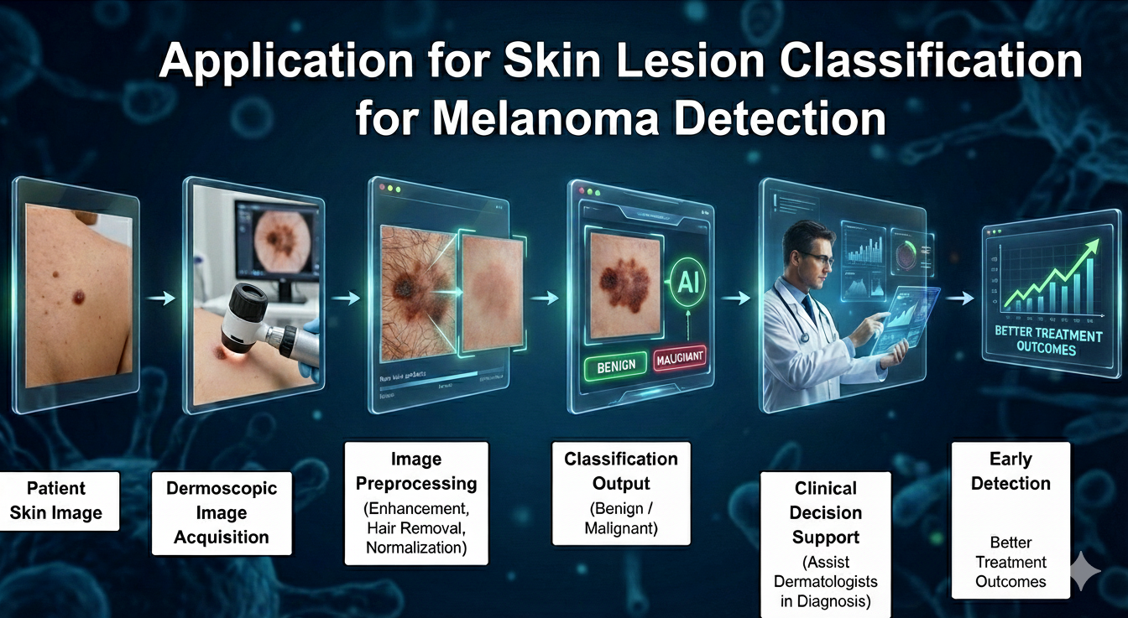
APPLICATION

Slide 5
LITERATURE REVIEW
Transformers in Skin Lesion Classification a Diagnosis (Aldealnabi et al, 2024)
Traditional CNN’s capture local features
Vision Transformers (ViTs) add global context and attention
Achieved 96% accuracy on HAM10000 dataset
Skin Lesion Analysis for Melanoma Detection Using Fuzzy GC-SCNN (Bhimavarapu et al, 2022)
Combined fuzzy logic, GrabCut segmentation, and stacked CNNs
Achieved 99.75% accuracy and 100% sensitivity
Handles uncertain lesion boundaries
A Deep Learning Framework for Automated early Diagnosis and Classification of Skin Cancer Lesions (Al-Waisy et al 2025)
Hybrid pipeline with preprocessing, segmentation, and ensemble classification
Used AGCWD, Mask R-CNN + GrabCut, HRNet+ attention
Achieved 100% accuracy and 99.9% AUC

Slide 6
HAM 10000 DATASET
Human against machine
10,015 images
7 categories
Lesion_id | Image_id | dx | dx_type | age | sex | localization
HAM_0000118 | ISIC_0027419 | bkl | histo | 80 | Male | scalp
HAM_0000118 | ISIC_0025030 | Bkl | histo | 80 | Male | scalp
HAM_0002730 | ISIC_0026769 | Bkl | histo | 80 | Male | Scalp
HAM_0002730 | ISIC_0125661 | Bkl | histo | 80 | Male | Scalp
HAM_0001466 | ISIC_0031633 | bkl | histo | 75 | Male | Ear

Slide 7
ALGORITHM/APPROACH/METHODOLOGY
Step 1
Dataset Collection: HAM10000 (includes benign &
malignant lesions).
Step 2
Preprocessing:Image resizing, normalization, data balancing, augmentation.
Step 3
Feature Extraction:Convolutional Neural Network for feature extraction and classification.
Step 4
Training:Backpropagation to minimize loss.
Step 5
Model Evaluation:Performance is assessed on unseen validation data using key metrics .
Step 6
Result Analysis –The final results are compared with
existing literature .

Slide 8
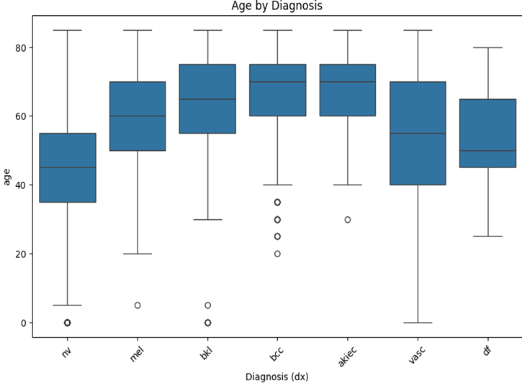
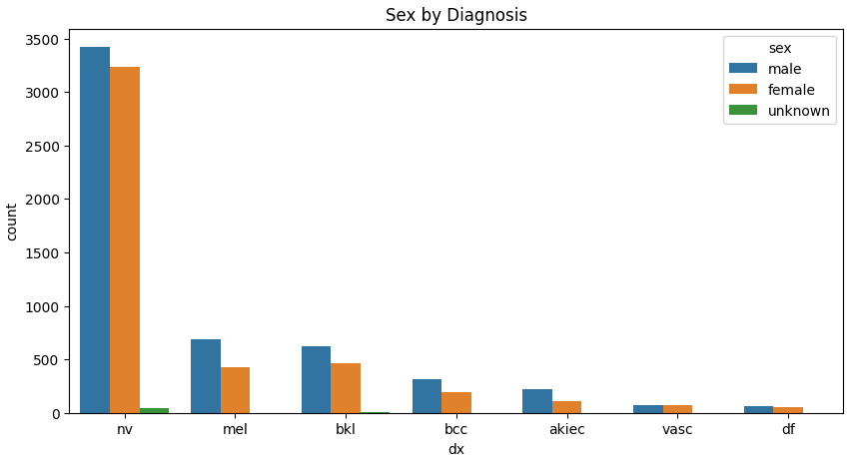
Data Exploration
Skin Lesions | Abbreviation
Melanocytic nevi | Nv
Melanoma | Mel
Benign keratosis | Bkl
Basal Cell carcinoma | Bcc
Actinic Keratoses | Akiec
Vascular lesions | vasc
dermatofibroma | df
Malignant

Slide 9
Data Pre-processing
Image Standardization
Resized and Normalized
Augmentation Techniques
Rotation, Flipping, Contrast adjustment
Image Enhancement
Hair removal
Malignant
Adebiyi, A. et. Al.(2024) Heath Informatics

Slide 10
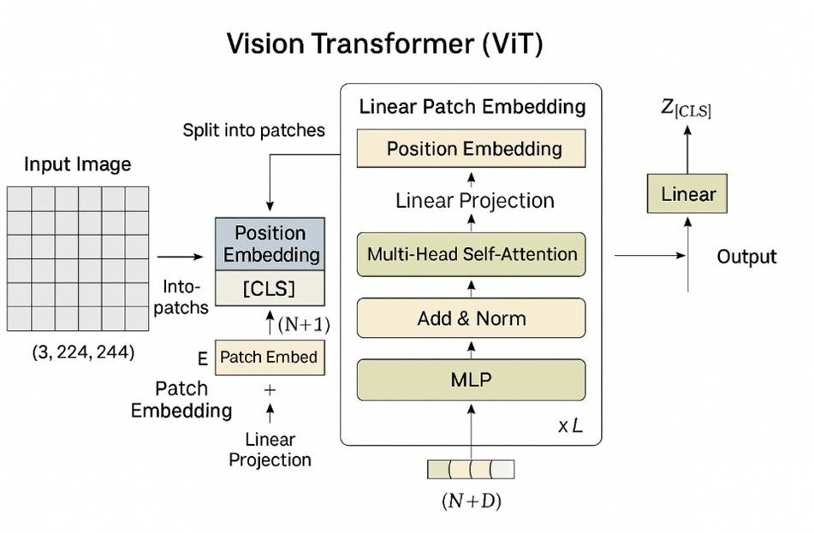
Transformer Model
Adebiyi, A. et. Al.(2024) Heath Informatics

Slide 11
Training Loop for ViT-Based Patch15-224
Validation Accuracy
Images & Labels
ViT (Forward)
CrossEntropy Loss
Backward Pass
AdamW Optimizer
Updated
Parameters
Running Loss (train loss)

Slide 12
UNDERSTANDING THE FUNCTIONS – ViT
Training Components
Codes | Description
Model=timm.create_model (vit- base_patch16-224) | Loads a pre-trained Vision Transformer model with a classification head
Criterion = nn.CrossEntropyLoss | Defines the loss function used to measure how far predictions are from true labels
Optimizer = optim.AdamW (model.parameter()) | Uses AdamW optimizer to update model weights efficiently while preventing overfitting

Slide 13
UNDERSTANDING THE FUNCTIONS - VIT
Training Breakdown
Codes | Description
Model.train() | Sets the model to training mode
For images, labels in train_loader | Iterates through mini-batches of data
Optimizer.zero_grad() | Clears old gradients before the next update
Outputs = model(images) | Forward pass through the ViT model
Loss = criterion(outputs, labels) | Computes classification loss
Loss.backward() | Performs backpropagation, computing gradients for all model parameters
Optimizer.step() | Updates model weights based on gradients
drop_rate = 0.3 | Randomly deactivating neurons during training to reduce overfitting and improve generalization

Slide 14
UNDERSTANDING THE FUNCTIONS - ViT
Tracking Performance
Codes | Description
Running_loss | Tracks average loss across batches for each epoch
Val_accuracies | Records accuracy on validation data to monitor progress
Best_acc | Keeps the highest validation accuracy for model checkpoints

Slide 15
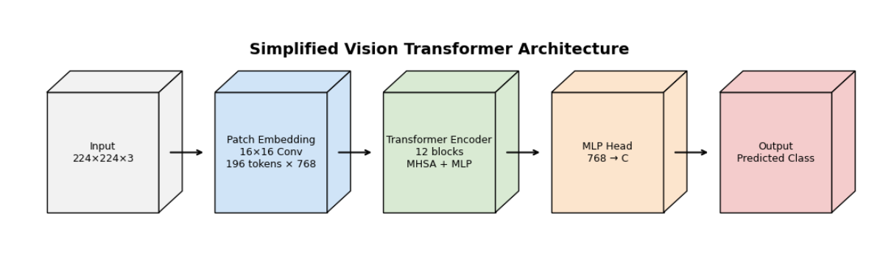
Vision Transformer Architecture

Slide 16
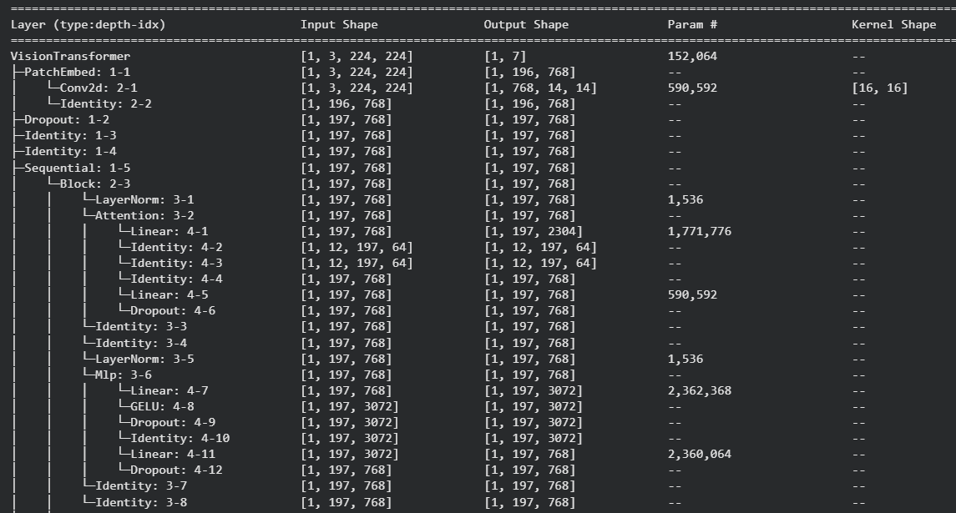
Model Summary
Parameter Type | Count
Total parameters | 85,804,039
Trainable | 85,804,039
Non-trainable | 0

Slide 17
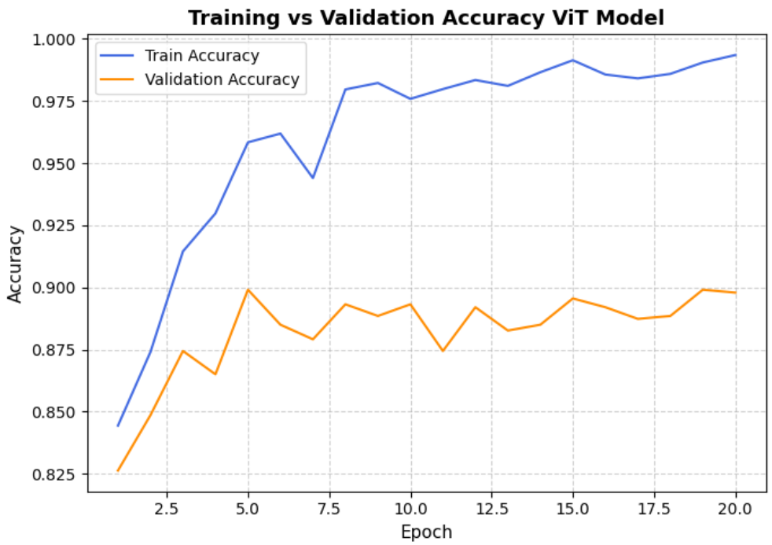
MODEL EVALUATION-ViT INITIAL MODEL
Conclusion

Slide 18
MODEL EVALUATION-ViT MODEL(Final acc PENDING)
Training Classification Report
Class | Precision | Recall | F1-Score | Support
Akiec | 0.93 | 0.93 | 0.93 | 250
Bcc | 0.95 | 0.97 | 0.96 | 393
Bkl | 0.98 | 0.88 | 0.93 | 841
Df | 1.00 | 0.92 | 0.96 | 88
Mel | 0.92 | 0.86 | 0.89 | 851
Nv | 0.96 | 0.99 | 0.98 | 5129
Vasc | 1.00 | 0.94 | 0.97 | 108
Overall Accuracy |  |  | 0.96 | 7660
Macro Avg | 0.96 | 0.93 | 0.94 | 7660
Weighted Avg | 0.96 | 0.96 | 0.96 | 7660
Testing Classification Report
Class | Precision | Recall | F1-Score | Support
Akiec | 0.80 | 0.67 | 0.73 | 49
Bcc | 0.84 | 0.90 | 0.87 | 77
Bkl | 0.87 | 0.70 | 0.77 | 165
Df | 0.92 | 0.71 | 0.80 | 17
Mel | 0.75 | 0.68 | 0.71 | 167
Nv | 0.92 | 0.97 | 0.95 | 1006
Vasc | 1.00 | 0.77 | 0.77 | 22
Overall Accuracy |  |  | 0.89 | 1503
Macro Avg | 0.87 | 0.77 | 0.82 | 1503
Weighted Avg | 0.89 | 0.89 | 0.89 | 1503

Slide 19
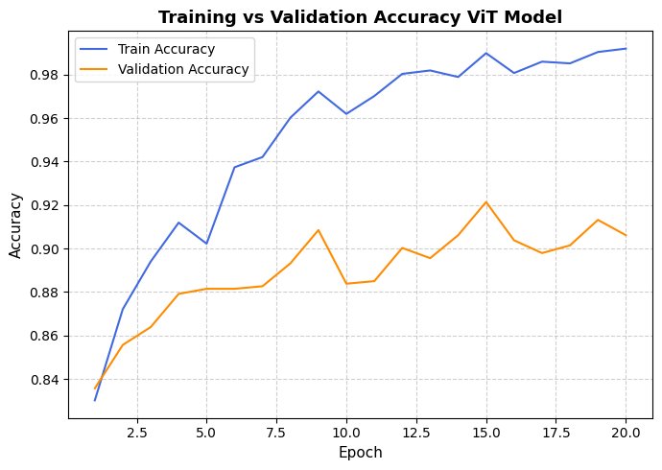
MODEL EVALUATION-ViT FINAL MODEL

Slide 20
Training Variations and Accuracy Improvement
Training | Epoch | LR | Drop Out | Drop Out Path | Training Accuracy | Validation Accuracy
Iteration 1 | 20 | 3e-5 | None | None | 91% | 87%
Iteration 2 | 20 | 3e-5 | 0.3 | 0.1 | 99% | 90%
Training Classification Report Iteration 2
Lesion Type | Precision | Recall | f1-Score
akiec | 0.94 | 0.99 | 0.96
bcc | 0.99 | 0.98 | 0.99
bkl | 1 | 0.96 | 0.98
df | 0.99 | 1 | 0.99
mel | 0.97 | 0.97 | 0.97
nv | 0.99 | 1 | 1
vasc | 0.99 | 0.99 | 0.99
Accuracy |  |  | 0.99
macro avg | 0.98 | 0.99 | 0.98
weighted avg | 0.99 | 0.99 | 0.99

Slide 21
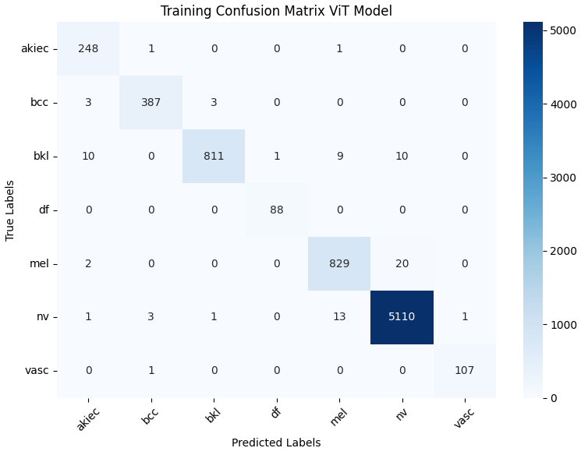
MODEL EVALUATION-ViT MODEL

Slide 22
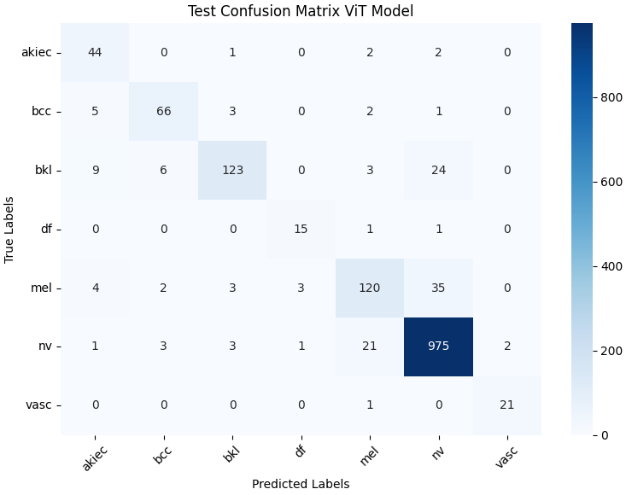
MODEL EVALUATION-ViT MODEL

Slide 23
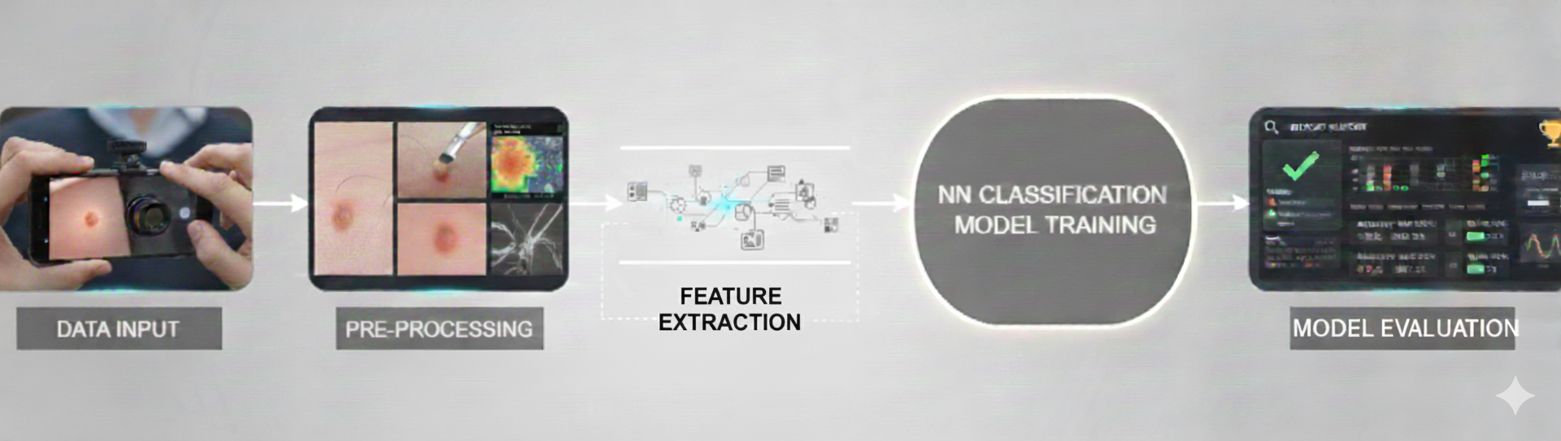
CNN Architecture
Image Enhancement
Hair Removal

Slide 24
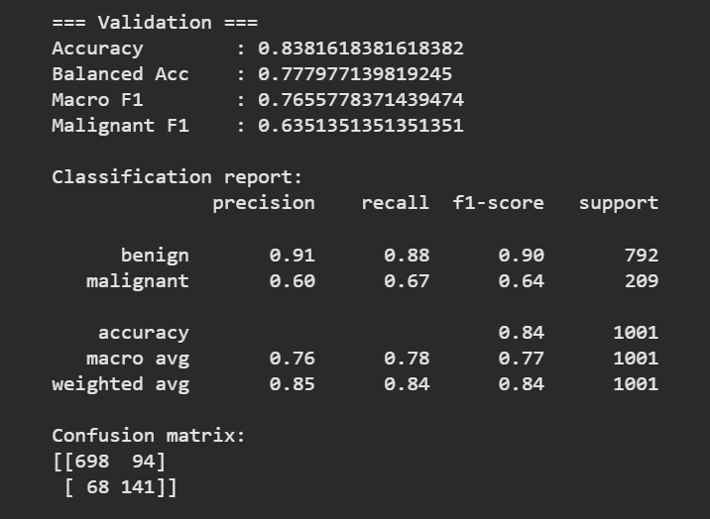
MODEL EVALUATION-CNN MODEL

Slide 25
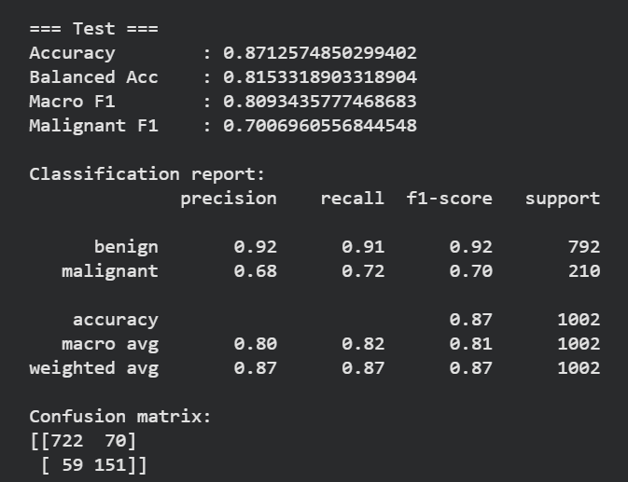
MODEL EVALUATION-CNN MODEL

Slide 26
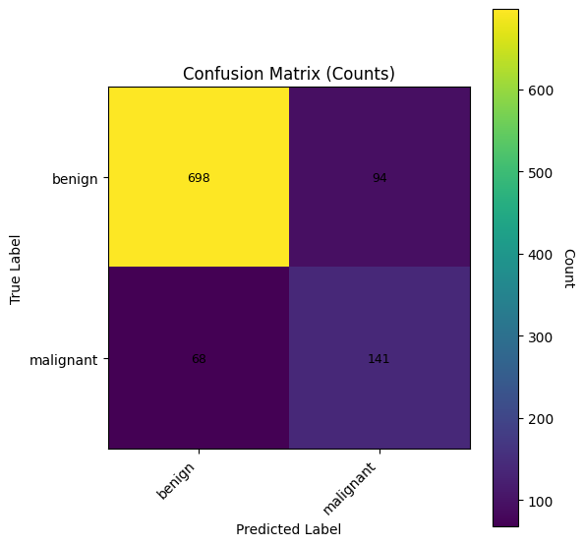
MODEL EVALUATION-CNN MODEL

Slide 27
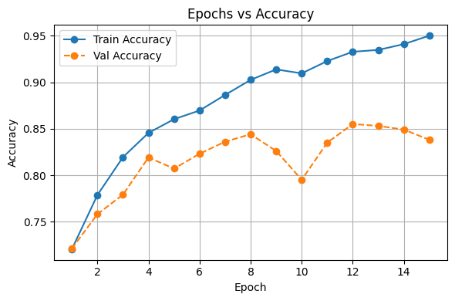
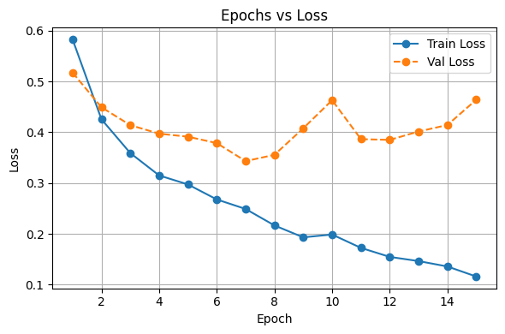
MODEL EVALUATION-CNN MODEL

Slide 28
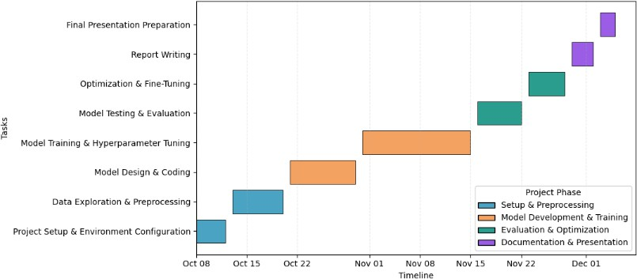
TIMELINE

Slide 29
MODEL COMPARISION: CNN, VIT MODEL, & RESEARCH
Aspect | CNN Model | VIT Model
Feature learning | Uses the convolutional layers to directly extract the spatial features | Uses the backpropogation, tranformer and feature extraction to deal with data
Accuracy | 87% | 99%
Effectiveness | More viable for less dataset sizes | More viable for large datasets sizes
Generalization | Works well for simple tasks like simple image classification | Works well for complex and complicated tasks like feature extraction and back propagation with hybrid data usage
Model | Training Accuracy | Loss
CNN | 87% | 0.83 (approx.)
VIT | 99% | 0.05 (approx.)
Research paper | Fuzzy GC-SCNN-99.75% Systemic review-96% | 0.0005 (approx.) 0.04(approx.)
31

Slide 30
CONCLUSION
ViT final model achieved 99% in training accuracy & close to 91% in validation accuracy
Captured both local details and global patterns in skin lesions.
Outperformed traditional CNN models in reliability and precision.
Shows strong potential for early and accurate melanoma detection.
Supports AI-assisted diagnosis for faster clinical decisions.

Slide 31
FUTURE WORK
Integrate the techniques from Skin Caner DeepNet such as adaptive contrast enhancement(AGCWD), hybrid Mask R-CNN + GrabCut segmentation.
Validate model robustness on larger and more diverse datasets such as ISCI 2019 and PH2
Employ visualization tools like Grad-CAM and attention
heatmaps to interpret ViT attention regions and improve clinical trust
Combine clinical metadata (e.g., patient history, lesion evolution) with image-based learning to enhance diagnostic
accuracy
Develop a web-based diagnostic tool for clinical testing.

Slide 32
REFERENCES
U. Bhimavarapu, G Battineni, “Skin Lesion Analysis for Melanoma Detection Using the Novel Deep Learning Model Fuzzy GC-SCNN”, Healthcare, vol. 10, no. 5, p.962, May 2022
American Academy of Dermatology, “Skin cancer,” AAD, June. 20, 2025. [Online]. Available: https://www.aad.org/media/stats-skin-cancer. [Accessed: Oct. 04, 2025].
A. Adealnabi, S. Eduardo J, M. Becevic, E. H. Smith, P Rao, “Transformers in Skin Lesion Classification and Diagnosis: A systematic Review, Health Informatics, September 2024.
A. S. Al-Waisy, S. AlFahdawi, M.I. Khalaf, M. A. Mohmmed, B. All- Attar, M.N. AL-Andoli, “ A Deep Learning Framework for Automated early Diagnosis and Classification of Skin Cancer Lesions in Dermoscopy Images”, Scientific Reports, vol. 15, no. 1, p.31234, August 2025

Slide 33


Questions

